Slide 1
DataOps/MLOps Project Assignment
Neil Scheidwasser, Raffaele Pojer

Slide 2
Overview
The rise of large language models (LLMs) has revolutionised Natural Language Processing (NLP).
Despite advancements, machine translation quality, especially speech-based, remains challenging.
Accurate Language Identification (LID) is crucial for multilingual settings, improving translation accuracy.
Example: parliaments where speakers speak in their native language
Our project focuses on developing a prototype for LID in North Germanic languages (Danish, Norwegian, Swedish, Icelandic, Faroese).

Slide 3
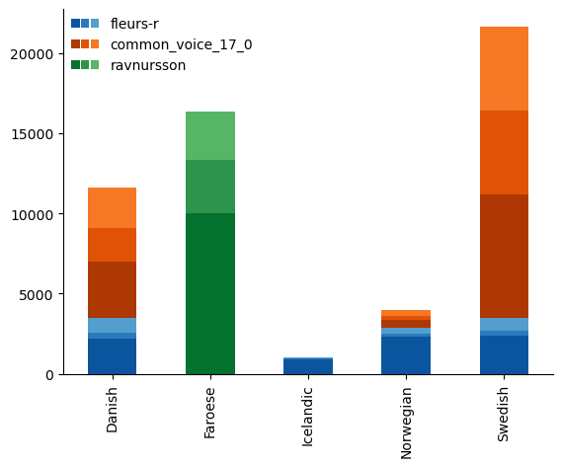
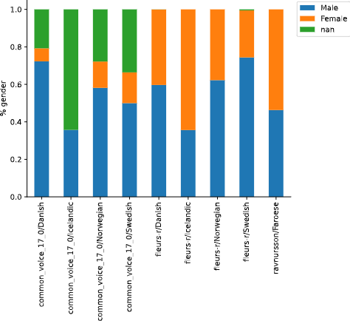
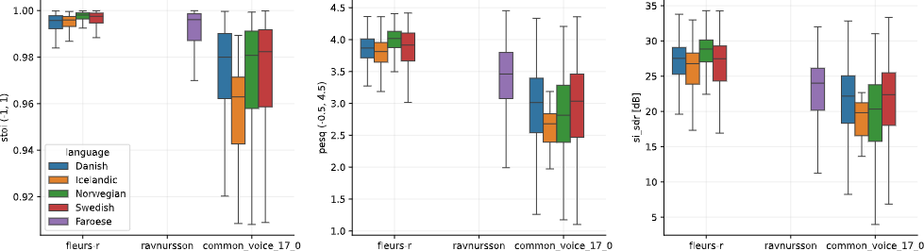
Data & preprocessing
Notes:
A diverse corpus of open-source datasets was used (FLEURS-R, Common Voice 17.0, Ravnursson).
Data quality assurance involved checks for duplicates, metadata adequacy, and potential gender and language biases.
Speech quality was assessed using torchaudio-squim, ensuring high-quality audio for training.
Speaker independence was also checked, in order to assess potential data leakage during training.

Slide 4
Model development
Two models were selected: XLS-R (high accuracy) and Titanet-LID (fast inference).
Name | Params (B) | Test accuracy (%) | Training runtime (min) | GFLOPS (for 1 s of audio)
ECAPA-TDNN | 0.022 | 90.0 | 24.0 | 3.8
Titanet-LID (LangID Ambernet) | 0.029 | 92.5 | 19.5 | 5.0
Whisper (tiny) | 0.04 | 87.9 | 34.4 | 40.6
Whisper (base) | 0.07 | 91.2 | 34.2 | 97.0
XLS-R (LID) | 0.3 | 97.7 | 41.7 | 35.6
MMS (126) | 1 | 97.5 | 77.5 | 99.5
Notes:
Weights & Biases (W&B) was used for tracking experiments and model versioning. W&B's comprehensive features enabled efficient model development and ensured reproducibility of experiments

Slide 5
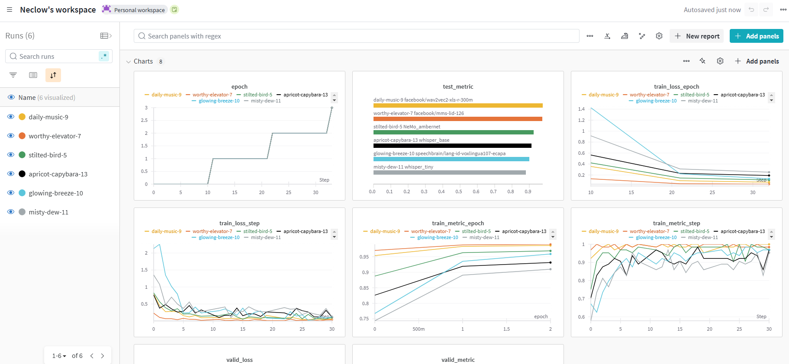
Model versioning using Weights & Biases

Slide 6
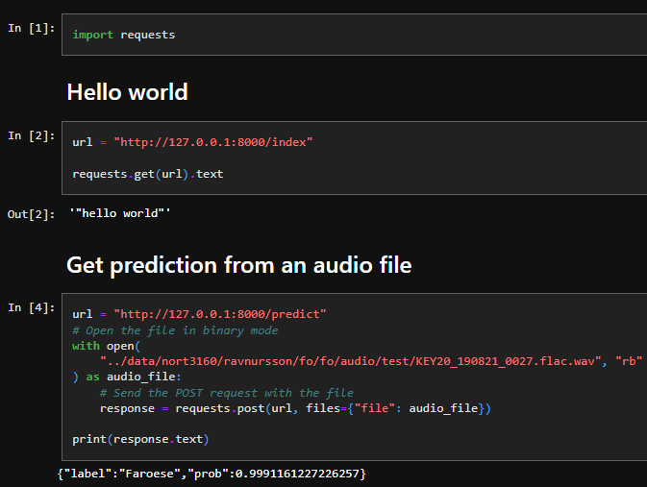
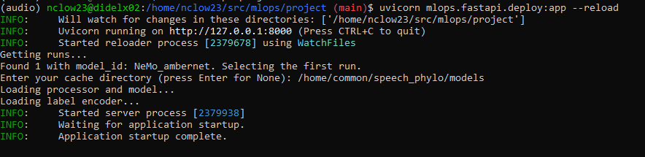
Model deployment using FastAPI
UseFastAPI to enable users to upload audio for language prediction.

Slide 7
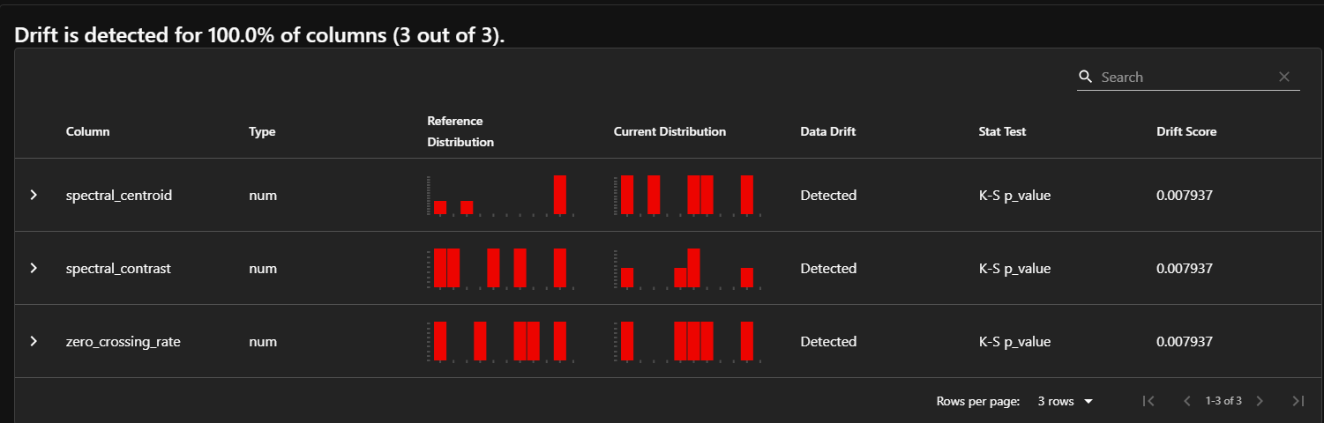
Model monitoring using Evidently AI
Real-time monitoring for data drift was implemented using Evidently AI
Evidently AI's DataDriftReport facilitated the detection of shifts in feature distributions, prompting retraining when necessary.
Data drift was simulated by adding noise to the audio data, mimicking real-world data variability

Slide 8
Prototype benefits
Benefits:
Versatility: model zoo incorporates highly accurate models (98%) or accurate and fast models (92% in 20 min of training)
User friendliness: accessible dashboard using W&B, simple API using FastAPI
Robustness: Data drift monitoring ensure reliable performance over time.
Openness: open data from Hugging Face and code (https://github.com/Neclow/mlops_project)

Slide 9
Future steps
Improve orchestration with advanced workflow management tools for better automation.
Explore scalable solutions for data processing and storage to handle larger data volumes and real-time processing
Establish a robust continuous training loop to keep models updated and accurate.

